Slide 1

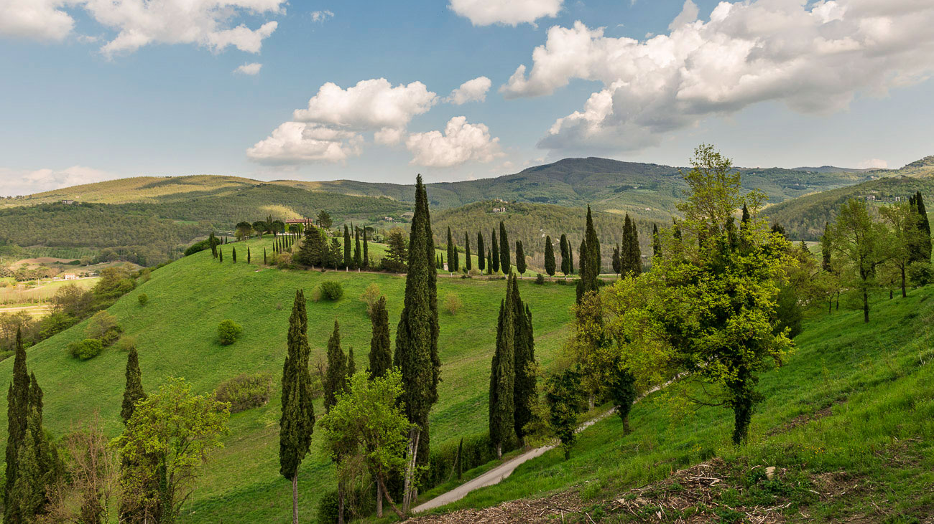



Slide 2
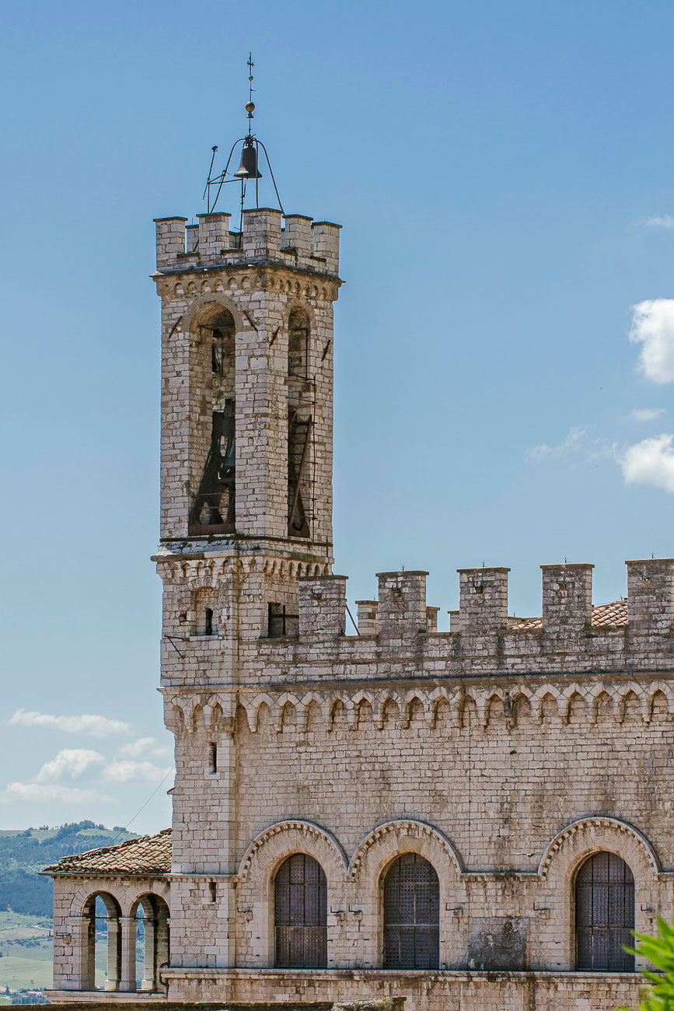
Welcome to Alta Umbria
Gubbio, Città di Castello and the hidden green heart of Italy
Rolling hills, forests, medieval towns and traditions
Far from mass tourism: authentic and slow living
Genuine food and strong rural communities

Slide 3
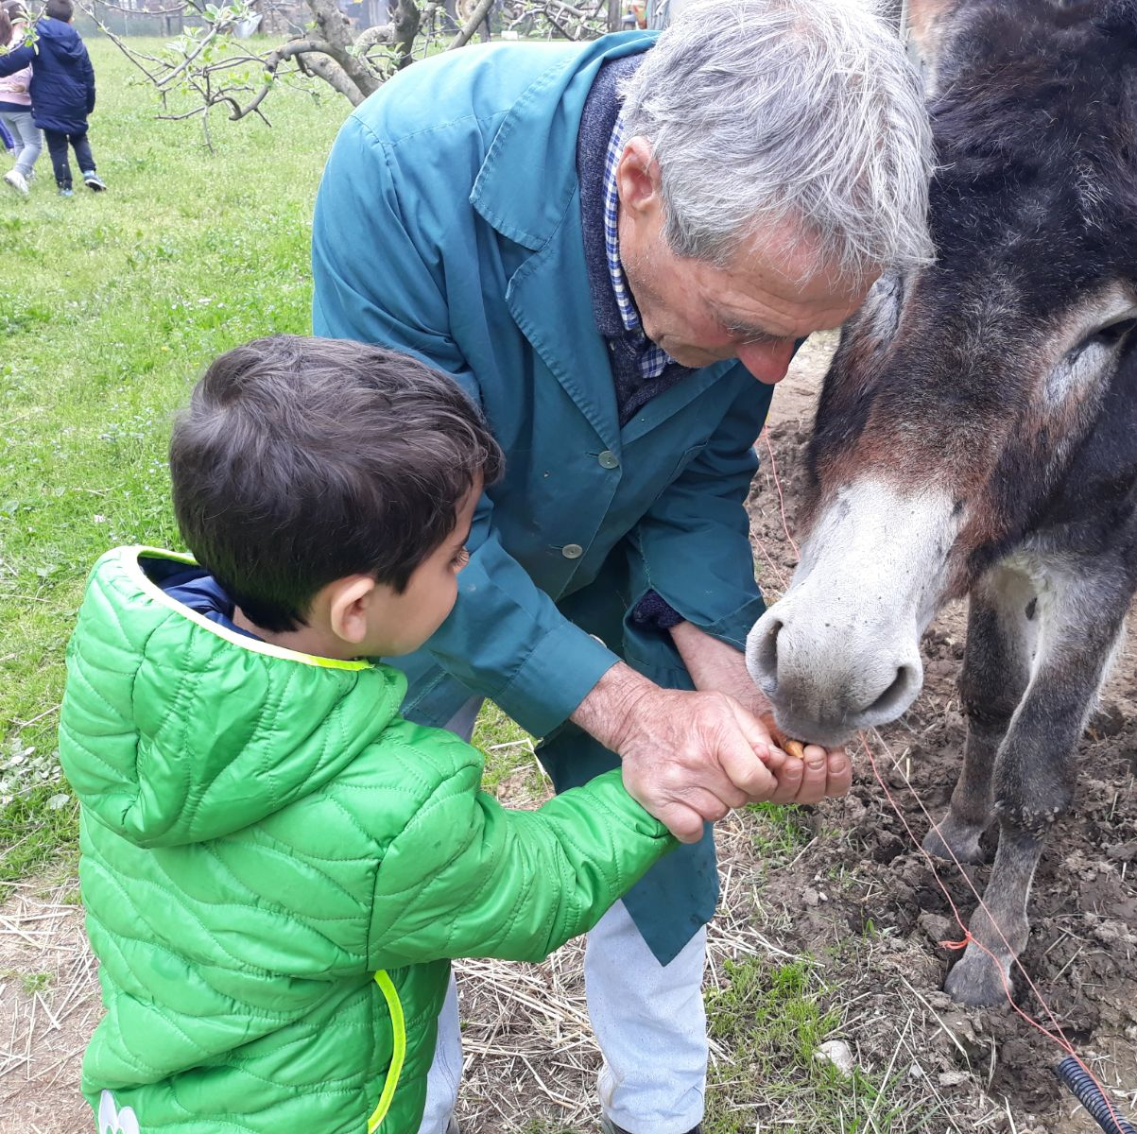
What makes this land special
Ancient farming and modern sustainability
Strong community ties and oral traditions
Culinary heritage as storytelling
Deep connection with seasons and land

Slide 4
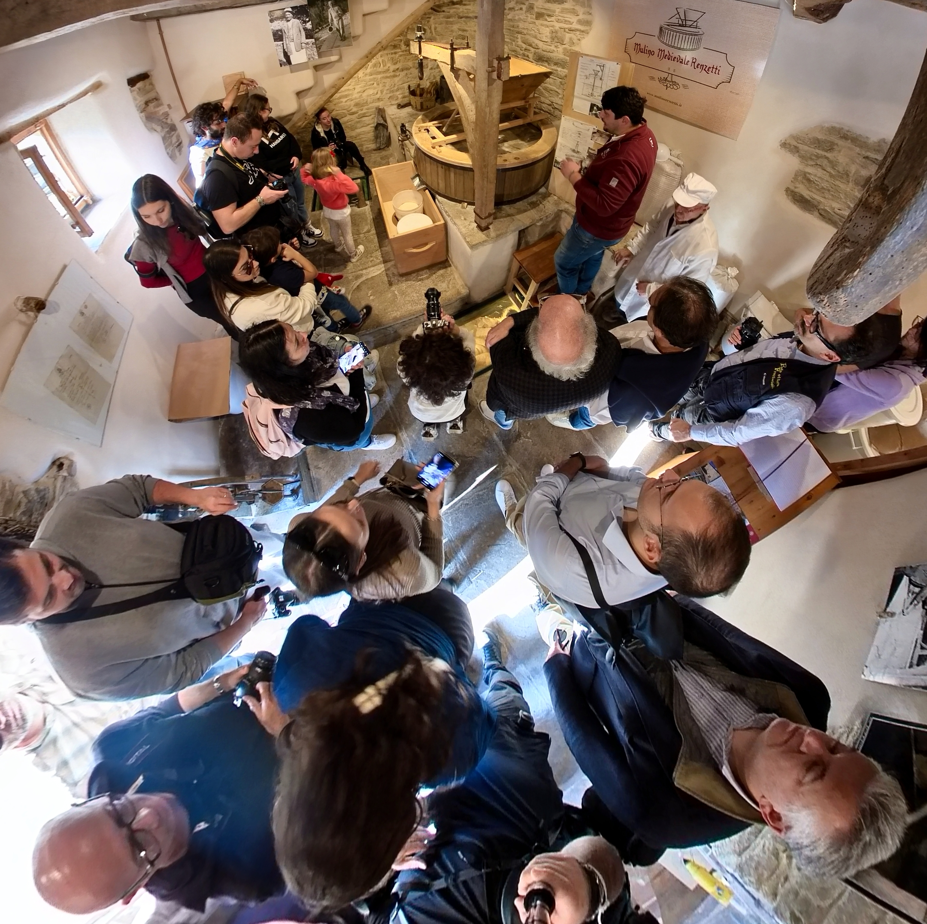
Local is better community
A new way to travel, taste and connect
Stay on farms, cook with locals
Focus on experience, not consumption
Regenerative for both land and community

Slide 5
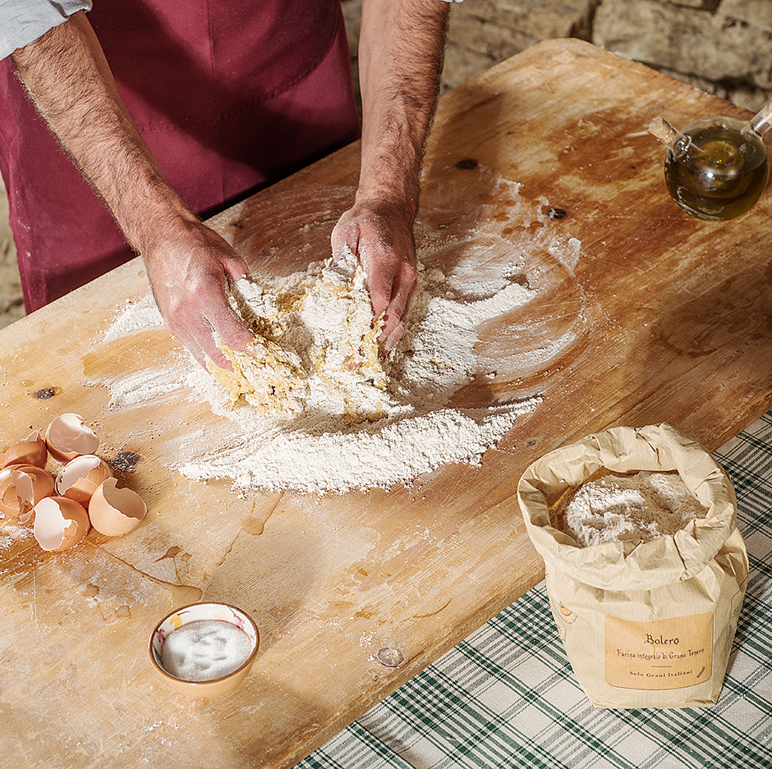
Food as identity and regeneration
Organic farms and traditional artisans
Meals linked to biodiversity and seasons
Learn and teach how and why food is made
Taste tangible sustainability

Slide 6
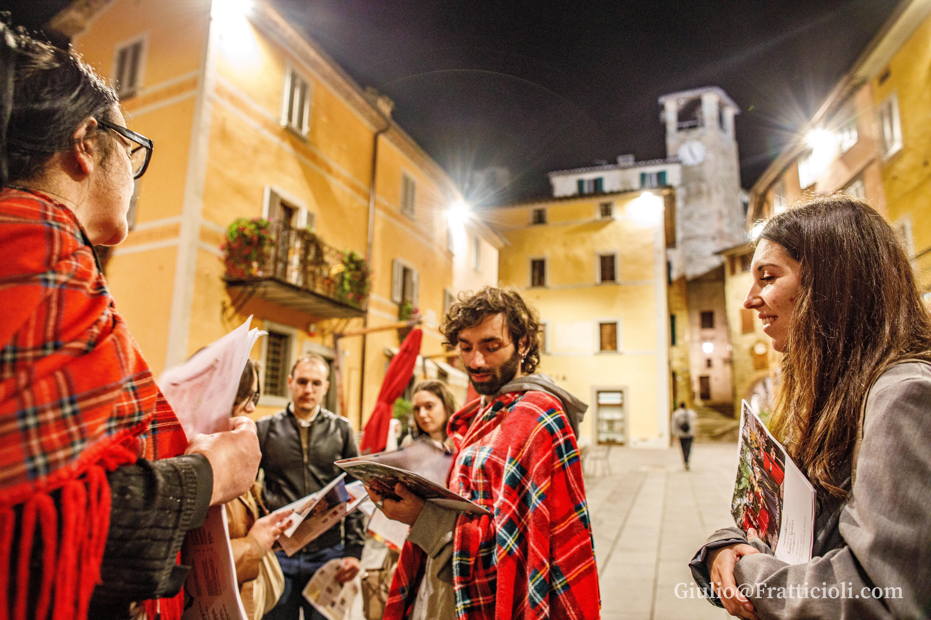
The community as a host
Hosts as cultural ambassadors
Storytelling and emotional connection
Beyond tourism: shared life moments

Slide 7
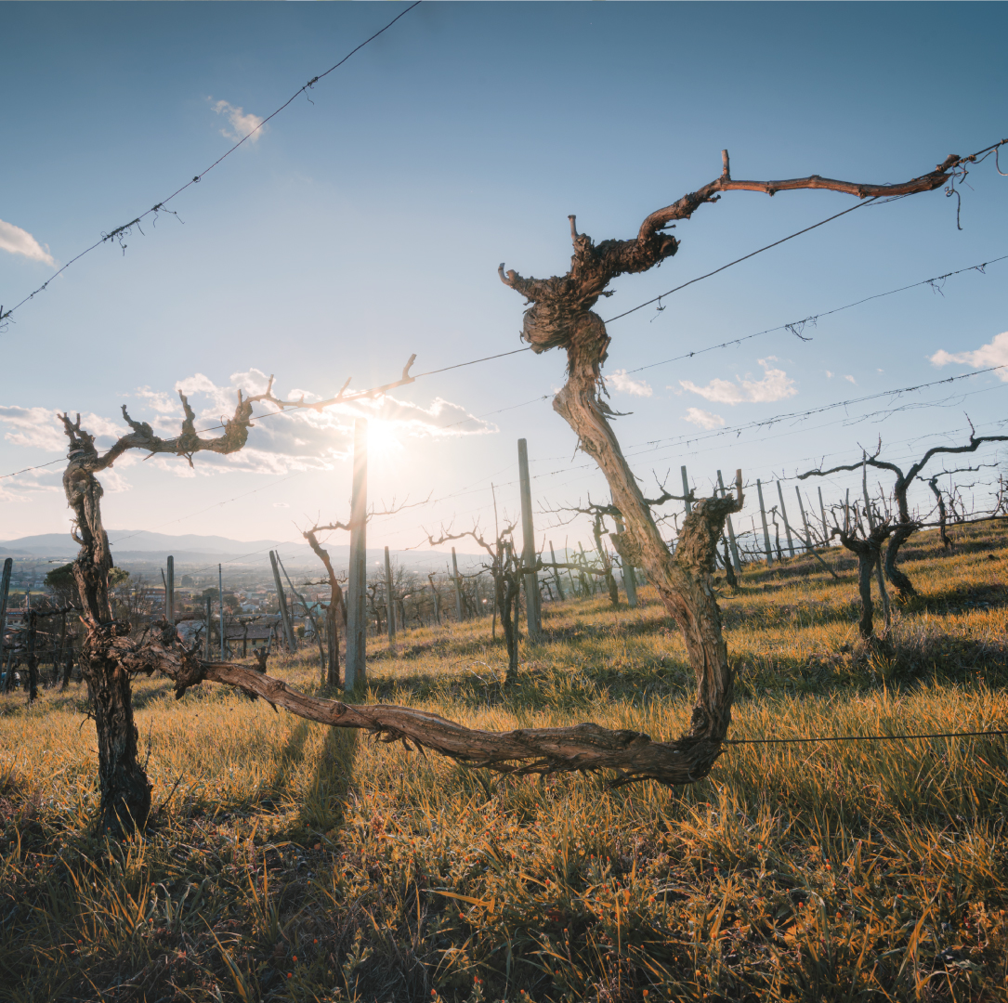
Let’s taste the roots of a different Italy
Small places
Not just travel — a journey into identity and sustainability
Local food
Local people
Real stories

Slide 8
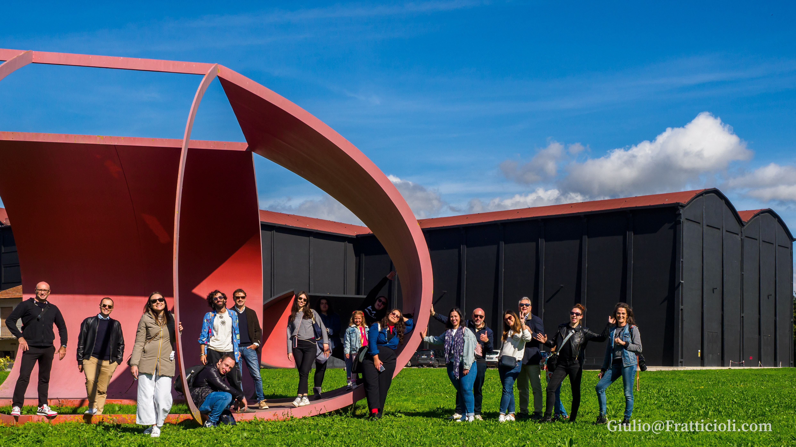
Local is better!
is waiting for you in Alta Umbria!

